Slide 1
Regression
Week 3
Mohammad Esmalifalak

Slide 2
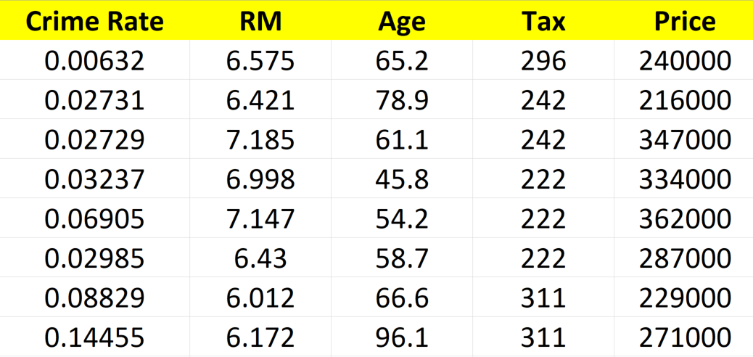
What is Regression?
Input variables, Features, X
Output, Label, Target, Y
??
Can we predict the price of a home based on input features?
Notes:
Crime rate: Per Capita

Slide 3
Other Examples of Regression
Label (Y) | Features (X)
Salary | Occupation, Education, Work Experience, etc.
Pollution | Engine Size, Year, Make, Model, etc.
Sales | Age, Education, Work Experience, etc.
Weather | Hour, Month, Location, etc.
Practice: Identify the regression problem,
1- Predicting Normal vs Abnormal 3- Grouping similar cars
2- Predicting if stock will rise or fall 4- Predicting stock price for tomorrow

Slide 4
Regression Algorithms
Bayesian linear regression
Neural network regression
k-nearest neighbors
Ordinal regression
Linear, polynomial,…

Slide 5






What is Our Goal?
For new house
Learning Algorithm
Estimated
$
$$h_{θ}(X)$$
Learning algorithm outputs a function called hypothesis.
Hypothesis function gets X_new and transforms them to y_hat.

Slide 6
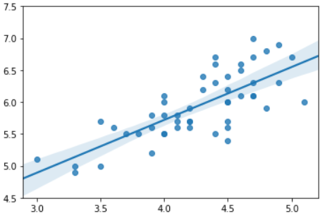

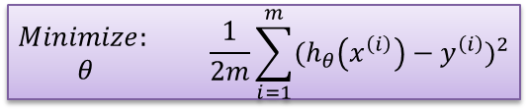

Linear Regression
Price (in $1000)
$$h_{θ}\left(X\right)=θ_{0}+θ_{1}x_{1}$$
error
Problem:
# of rooms
Find $_{0}$ and $_{1}$ such that mean square error gets minimum for all training samples
$$\begin{matrix}Minimize: \\ θ\end{matrix} \frac{1}{2m}\sum_{i=1}^{m}{{(h_{θ}\left(x^{\left(i\right)}\right)−y^{\left(i\right)})}^{2}}$$
also call cost function ${J(}_{0},_{1}$)

Slide 7



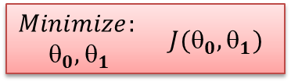

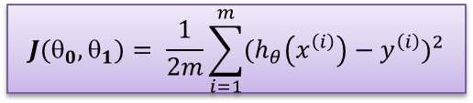
Recap
Hypothesis:
Cost Function:
$$h_{θ}\left(X\right)=θ_{0}+θ_{1}x_{1}$$
$${J(θ}_{0},θ_{1}\text{)}= \frac{1}{2m}\sum_{i=1}^{m}{{(h_{θ}\left(x^{\left(i\right)}\right)−y^{\left(i\right)})}^{2}}$$
Goal:
$\begin{matrix}Minimize: \\ _{0},θ_{1}\end{matrix} J(θ_{0},θ_{1})$
$$h_{θ}\left(X\right)$$
For better visualization of $J(_{0},_{1})$ , lets assume $_{0}=0$
$$x_{1}$$

Slide 8















Visualizing $h_{θ}\left(X\right)$ and $J(θ)$
Hypothesis:
Cost Function:
$$h_{θ}\left(X\right)=θ_{0}+θ_{1}x_{1}$$
$${J(θ}_{0},θ_{1}\text{)}= \frac{1}{2m}\sum_{i=1}^{m}{{(h_{θ}\left(x^{\left(i\right)}\right)−y^{\left(i\right)})}^{2}}$$
$$h_{θ}\left(x_{1}\right)$$
$$J\left(θ_{1}\right)$$
$$3$$
$$2$$
1
$$+$$
$$3$$
$$2$$
1
$$+$$
$_{0}$=0
$_{1}$=1
$$+$$
$$x_{1}$$
$$+$$
$$1 2 3$$
$$_{1}$$
$$1 2 3$$
$J(0,1\text{)}= \frac{1}{6}$(${(1−1)}^{2}$ +${(2−2)}^{2}\text{ +}{(3−3)}^{2})$=0
Notes:
Lets understand h and j functions by plotting them (for simple case of theta_0=0)

Slide 9








Visualizing $h_{θ}\left(X\right)$ and $J(θ)$
Hypothesis:
Cost Function:
$$h_{θ}\left(X\right)=θ_{0}+θ_{1}x_{1}$$
$${J(θ}_{0},θ_{1}\text{)}= \frac{1}{2m}\sum_{i=1}^{m}{{(h_{θ}\left(x^{\left(i\right)}\right)−y^{\left(i\right)})}^{2}}$$
$$h_{θ}\left(x_{1}\right)$$
$$J\left(θ_{1}\right)$$
$$3$$
$$2$$
1
$$+$$
$$3$$
$$2$$
1
$$+$$
$_{0}$=0
$_{1}$=0
$$+$$
$$+$$
$$x_{1}$$
$$+$$
$$1 2 3$$
$$_{1}$$
$$1 2 3$$
$J(0,0\text{)}= \frac{1}{6}$(${(0−1)}^{2}$ +${(0−2)}^{2}\text{ +}{(0−3)}^{2} )$=2.33
Notes:
Lets understand h and j functions by plotting them (for simple case of theta_0=0)

Slide 10





Visualizing $h_{θ}\left(X\right)$ and $J(θ)$
Hypothesis:
Cost Function:
$$h_{θ}\left(X\right)=θ_{0}+θ_{1}x_{1}$$
$${J(θ}_{0},θ_{1}\text{)}= \frac{1}{2m}\sum_{i=1}^{m}{{(h_{θ}\left(x^{\left(i\right)}\right)−y^{\left(i\right)})}^{2}}$$
$$h_{θ}\left(x_{1}\right)$$
$$J\left(θ_{1}\right)$$
$$+$$
$$3$$
$$2$$
1
$$+$$
$$3$$
$$2$$
1
$$+$$
$$+$$
$$+$$
$_{0}$=0
$_{1}$=2
$$+$$
$$+$$
$$+$$
$$x_{1}$$
$$+$$
$$1 2 3$$
$$_{1}$$
$$1 2 3$$
$J(0,2\text{)}= \frac{1}{6}$(${(2−1)}^{2}$ +${(4−2)}^{2}\text{ +}{(6−3)}^{2} )$=2.33
Notes:
Lets understand h and j functions by plotting them (for simple case of theta_0=0)

Slide 11
Visualizing $h_{θ}\left(X\right)$ and $J(θ)$
Hypothesis:
Cost Function:
$$h_{θ}\left(X\right)=θ_{0}+θ_{1}x_{1}$$
$${J(θ}_{0},θ_{1}\text{)}= \frac{1}{2m}\sum_{i=1}^{m}{{(h_{θ}\left(x^{\left(i\right)}\right)−y^{\left(i\right)})}^{2}}$$
$$h_{θ}\left(x_{1}\right)$$
$$J\left(θ_{1}\right)$$
$$+$$
$$3$$
$$2$$
1
$$+$$
$$3$$
$$2$$
1
$$+$$
$$+$$
$$+$$
$_{0}$=0
$_{1}$=2
$$+$$
$$+$$
$$+$$
$$x_{1}$$
$$+$$
$$1 2 3$$
$$_{1}$$
$$1 2 3$$
$J(0,2\text{)}= \frac{1}{6}$(${(2−1)}^{2}$ +${(4−2)}^{2}\text{ +}{(6−3)}^{2} )$=2.33
Notes:
Lets understand h and j functions by plotting them (for simple case of theta_0=0)

Slide 12





Finding Optimal $_{0}$, $_{1}$
Gradient Descent:
Start with random $_{0}$, $_{1}$
U$pdate _{0}$, $_{1}$ to reduce ${J(θ}_{0},θ_{1}\text{)}$
${J_{new}(θ}_{0},θ_{1}\text{)}$ is good enough?
No
Yes
Print optimal $J,$ $_{0}$ and${ }_{1}$

Slide 13
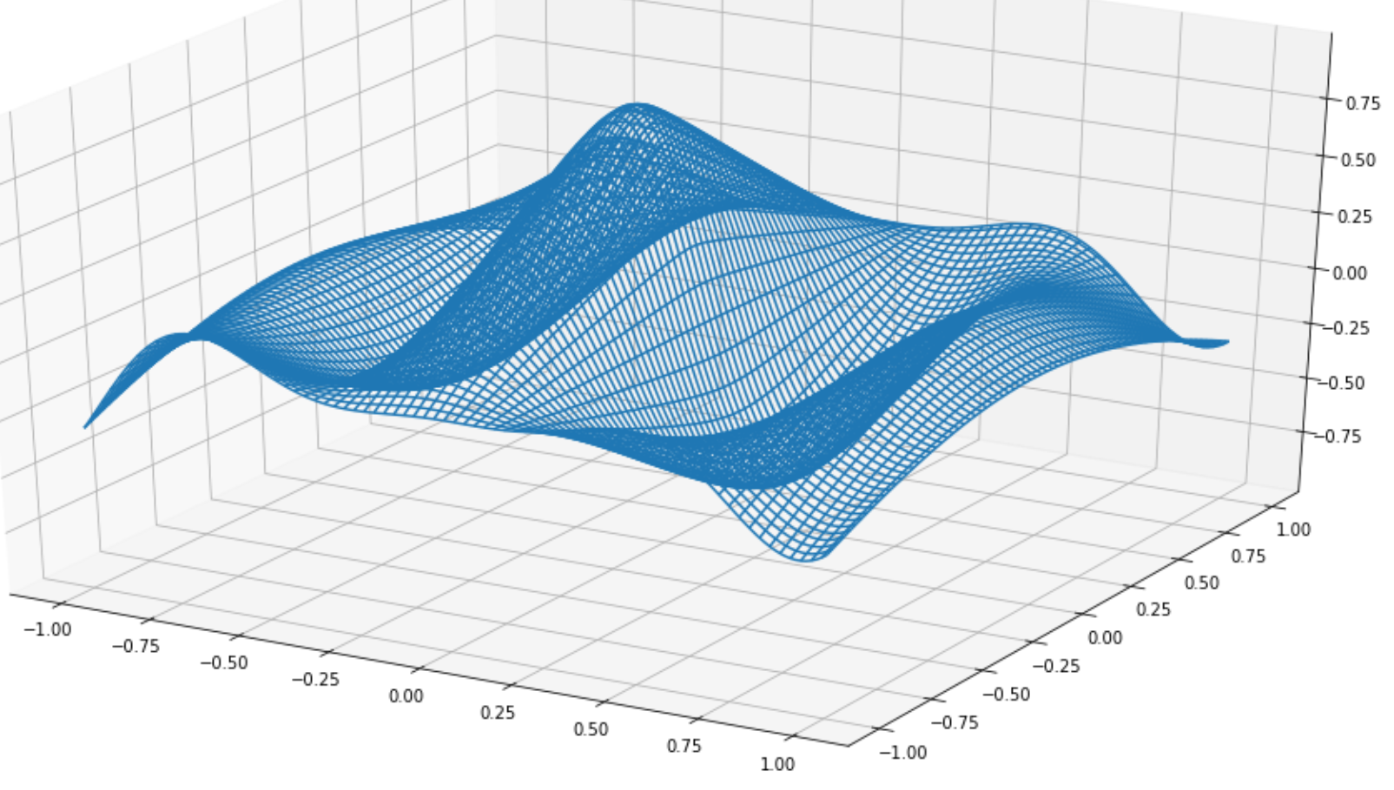

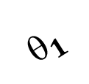

Regression Algorithms
$${J(θ}_{0},θ_{1}\text{)}$$
$$_{1}$$
$$_{0}$$

Slide 14





Gradient Descent
Repeat until convergence {
}
$_{0}$ := $_{0} − α \frac{∂}{∂θ_{0}}J\left(θ_{0},θ_{1}\right)$
$_{1}$ := $_{1} − α \frac{∂}{∂θ_{1}}J\left(θ_{0},θ_{1}\right)$
$Temp1$ := $_{0} − α \frac{∂}{∂θ_{0}}J\left(θ_{0},θ_{1}\right)$
$Temp2$ := $_{1} − α \frac{∂}{∂θ_{1}}J\left(θ_{0},θ_{1}\right)$
$_{0}$:=Temp1
$_{1}$:=Temp2
$Temp1$ := $_{0} − α \frac{∂}{∂θ_{0}}J\left(θ_{0},θ_{1}\right)$
$_{0}$:=Temp1
$Temp2$ := $_{1} − α \frac{∂}{∂θ_{1}}J\left(θ_{0},θ_{1}\right)$
$_{1}$:=Temp2

Slide 15
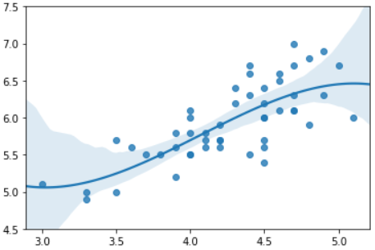
Linear Regression
Non-Linear Regression
Price (in $1000)
Price (in $1000)
# of rooms
# of rooms

Slide 16
Training vs Testing
Why we should split the data to, Train set and Test set?
1- To make sure model will perform well on future data (not just historical data)
2- To make sure we are not over-fitting or under-fitting data
y
y
y
x1
x1
x1
Over-fitted
Under-fitted
Just right!

Slide 17


